Slide 1
Action taken in preparation of SPAP by Working Groups
by Handloom Textiles and Sericulture Department

Slide 2
Working Groups and SDGs
WG:1
SDG2 (Zero Hunger)
WG:5
SDG8 (Decent work and economic growth)
WG:
SDG17 (Revitalising global Partnership)

Slide 3
SDGs mapped to UDD
HTS Dept
Goal 1 End poverty)
Goal 3 Good health & well being
Goal 5 (Gender education)
Goal 2 End hunger
Goal 6 (Clean water & Sanitation)
Goal 8 (Decent work & Economic growth)
Goal 10 Reduce Inequality
Goal 12 (Responsible consumption and production)
Goal 13 (Combat Climate change in its impact)
Goal 15 (Sustainable Eco system and Forest)
Goal 16 (Peace, Justice and strong Institution)
Goal 17 (Partnership for the Goals)

Slide 4
INPUTS FOR THE SPAP SUBMITTED TO THE RESPECTIVE WORKING GROUPS
Mandate of the Directorates of Handloom & Textiles and Directorate of Sericulture
Organisational Structure
Organisation and Institutions under the Directorates
Organised sector under Handloom & Textiles and Sericulture
Basic information on Handloom & Textile sector as well as Sericulture sector of Assam
Various schemes implemented under State and Central Govt. schemes.
Vision 2030 for both the Directorates

Slide 5
Existing Schemes mapped to the Goals
Cent-ral Govt
CSB
State Govt
Convergence Funds
DC Handlooms
DC
Handicrafts

Slide 6
Strength-based Strategies for SDGs
Rising weaver population (CULTURE)
38% and 47%
GI for Muga
HandloomCensus 2009, NCAER
38% of Country’s weavers and 47% of country’s looms are in Assam!?

Slide 7
Strategies for SDG2030
Empowered Communities-
Ethical Consumerism
Handloom Textiles
Productivity
E-tailing
Sericutlure
Silkworm-Seed
Rearing
Host plantation
Area
productivity

Slide 8
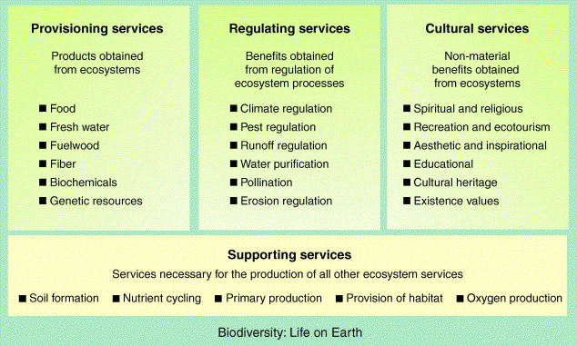
Approach is Ecosystems Services

Slide 9
Thus.. Strategy Paper covers
Community empowerment
Ecosystem Services Approach
Technology, marketing and e-tailing

Slide 10
Action Plan
Mission Mode Approach
An SPV: Assam Silk Outreach Mission (ASOM) Society
First three years: Focus on host plantation
Thereafter: Increased Silk Production and textiles

Slide 11
Goals by 2026
Improved Looms, Design/e-tailing
5 X Mulberry
5 X Eri
10 X Muga raw silk

Slide 12
MISSION OBJECTIVES
To increase production of Muga silk to ten-fold and of Eri silk to five-fold and Mulberry Silk.
To increase the employment opportunities in rural areas through year-round activities and augmenting the land-based income and thus per capita income in rural areas.
To innovate and introduce cutting–edge technology in rearing and weaving without diluting the advantages of handloom techniques.
Positive interventions to build on the strength of primary stakeholders (rearers and weavers) and establish end-to-end linkages with markets and consumers within and outside country using modern technology.
Strengthen the local initiatives and organizing Rearers Based Organizations (RBOs) and Weaver Based Organizations (WBOs) to take advantage of pool of traditional talent and resources to transform the disjointed production into critical mass of marketable raw silk and woven finished products.

Slide 13
MISSION OBJECTIVES
Innovations would be anchored on:
Traditional and indigenous knowledge.
Strong, healthy and scientific systems for production of silkworm seeds
Muga (already registered as GI) and developing it as unique global brand
Innovations in looms and designs
Better ergonomics and working conditions
Promoting “Handloom Mark” on the lines of “Woolmark”
Promoting “Assam Handloom Brand”
E-commerce

Slide 14
Gaps Analysed
Host Plantations-Areas identified
Private Graneurs/support required
Rearers/weavers organizations
Loom upgradation
Skill upgradation
Marketing and e-tailing

Slide 15
Resources Required
Land resources
Community Resources
Financial Resources: Rs 2500 crore required

Slide 16
PPP centered…
People
18 lakh weavers/rearers
Projects
Assam Silk Outreach Mission: 6 projects
Partnerships
Community
Private
Bilateral/multilateral
HTS Department

Slide 17
First Draft Plan for 2016-2019
Attempted
Submitted to the WGs

