Slide 1
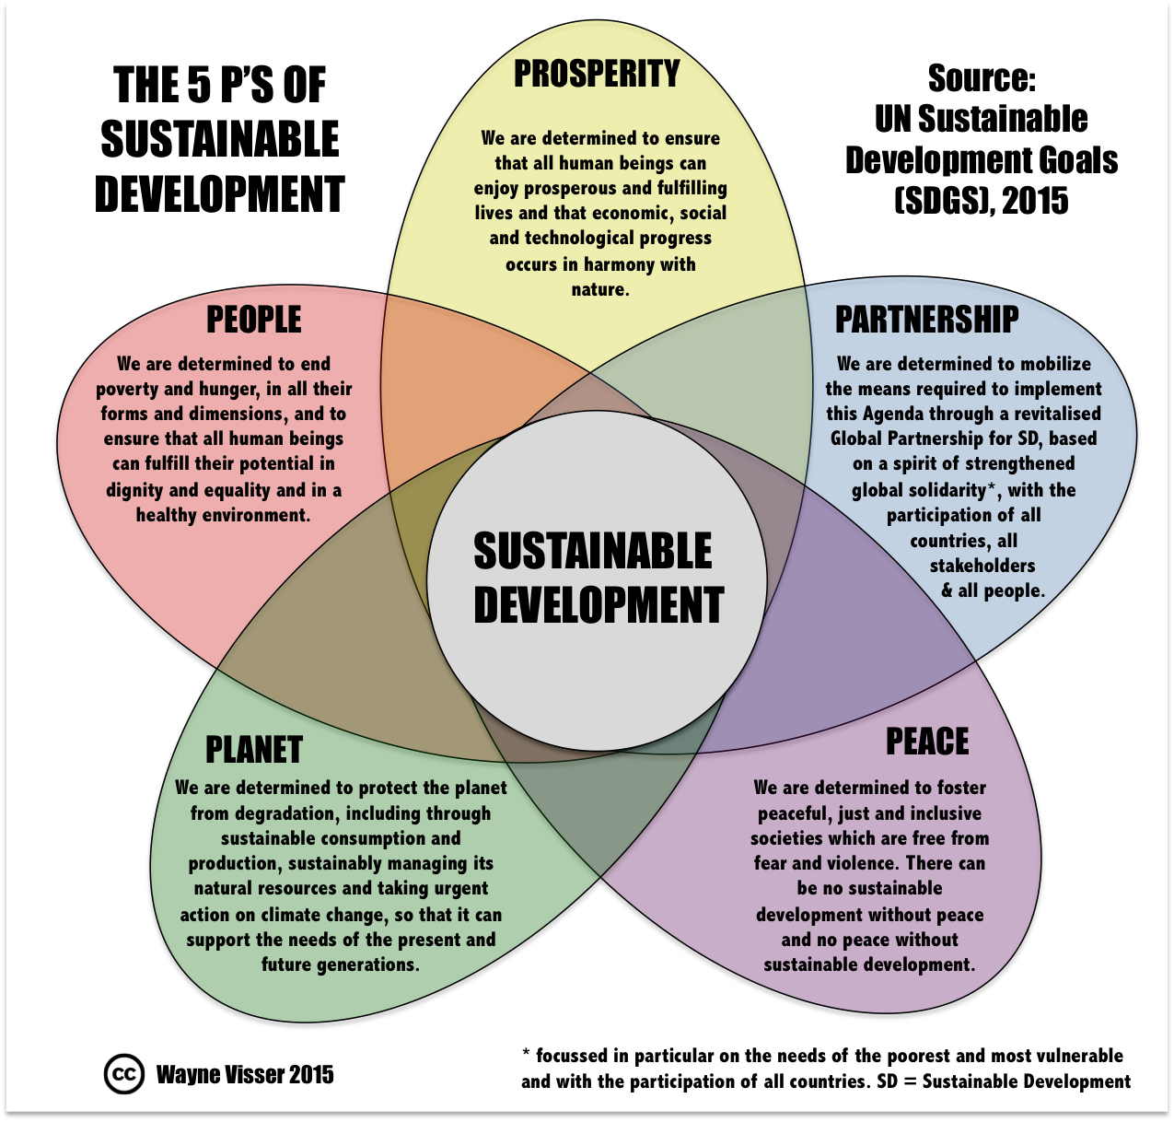
Sustainable Development Goal (SDG)
Quality Education
Department of Education, Govt. of Assam

Slide 2
Vision
To create a conducive environment for quality and inclusive education to all children of the age group of 6-18 years within 2025.
To provide equitable opportunities for Higher life skills/learning to all students to pursue higher studies and provide the required knowledge base and professional manpower to the state and country.
Every one in school & receive Quality Education

Slide 3
Present status on basic indicators
Indicators | Source: DISE 2015-16
Child Population | 5582166
Enrolment
Boys | 2663806
Girls | 2695583
Total Enrolment | 5359389
Number of Schools
Govt./Provincialise | 49502
Local Body/TG Managed | 52
TG Managed | 429
Govt. aided | 3898
Private | 3760
Un-recognised(Venture) | 7571
KGBV/ RS | 59
Central/Others | 350
Total Schools | 65621
Out of school | 106646
% of Retention LP | 68.75%
% of Retention UP | 86.37%

Slide 4
Present status on basic indicators
Indicators | Source: DISE 2015-16
% of Drop out LP | 16.50%
% of Drop out UP | 12.20%
GER(LP) | 106.1
GER(UP) | 79.53
NER(LP) | 99.6
NER(UP) | 66.49
Gender Parity Index-Elementary | 1.012
Transition Rate (LP to UP) | 84.30%
PTR-LP | 26
PTR-UP | 16

Slide 5
Comparison of Indicators Assam Vs India as per DISE-2014-15:

Slide 6
Learning level of children : SLAS and NAS
SLAS 2014-15 ( conducted in 7 districts)
Class | L-I | Maths | EVS | Science
II | 44.76 % | 58 %
III | 52.11 % | 53 % | 58 %
VIII | 49.37 % | 31 % |  | 37 %
SLAS 2015-16 ( conducted in 14 districts)
Class | L-I | Maths | EVS | Science | Social Science
III | 55 % | 57 % | 52 %
V | 61 % | 53 % | 51 %
VIII ( for 11 out of 14 sample districts) | 60 % | 38 % |  | 47 % | 43 %
NAS ( Class III; Cycle 3, Report of 2014)
Subject | National average | State average
Language | 257 | 253
Mathematics | 252 | 249

Slide 7
Mandate of the Department of Elementary Education & Source of Mandate
To ensure Free and Compulsory Equitable Quality Education for all children of the age group of 6-14 years.
Source:
Right to Education Act (RTE), 2009 Link
NCTE Gazette, Norms and Guideline, 2014 Link
The Preamble in the Assam Elementary Education (Provincialisation) Act, 1976 and modification thereof.
NCERT/SCERT/NCTE norms
Plantation Labour Act,1951 Link
Guidelines for implementation of Centrally Sponsored Scheme on Teacher Education(CSSTE) Link

Slide 8
Action Points against our mandate : Access
Year | Specific Target | Strategies | Remarks
2016-2025 | 100% achievement by 2019 | Adequate number of Primary to upper primary schooling facility | By 2019
 |  | Micro Survey for Transport and Escort facility assessment . | During 2016-17
 |  | Completion of Class room construction | By 2025
 |  | Completion of Toilet construction/repair | By 2019
 |  | Drinking Water facility | By 2017
 |  | Ramp with Hand Rail | By 2025
 |  | Boundary Wall | By 2025
 |  | Bringing of Out of School children into the fold of elementary education | By 2019
Gap in Link

Slide 9
Action points against our Mandate
Quality
Govt. School
Private School
Community School
Accountability of teachers
Adequate qualified teachers
Ownership/accountability
School Leadership
Specific rule and regulation
Teacher
Teacher
Supervision
Monitoring mechanism
Supervision & Monitoring & onsite support
[using IT Platform]
Infrastructure
Uniform & standard curriculum
Student’s performance
Adequate training for teachers
Teachers performance & students performance
Awareness
Community Participation [PRI/SMC/MG/EV etc.]
School achievement

Slide 10
Action Points against our mandate for Special Category : Access & Quality
School/Teacher/
Community participation/Special Incentives/Disaster friendly setup in school/Sanitation and Hygiene/Residential school facility .
Transport and escort facilities, self defense programme/residential school for girls/sanitation and hygiene/ scholarship & incentives .
Char
Girl
CWSN
Hilly
TG
School/Teacher/Community participation/Special Incentives/ Recreational activities/ Crech facility /Sanitation and Hygiene/Residential school facility Support to TGMS /etc.
AREA
Transport & Escort/ Teachers’ training/ Community participation /Aids & appliances/ Therapy service/ Inclusive Environment
Ethnic
School/Teacher/
Community participation/
Special Incentives/ Residential school facility/Transport & Escort
Teacher /bridge language/ transport & escort facilities/ special scholarship and incentives

Slide 11
Elementary Education Department
Directorate of Elementary Education
DEEO/DPEO [27]
DIS [47]
BEEO/BPEO [137]
SIs [295]
Schools
[LP & UP]
Urban Area
Schools
[LP & UP]
Rural Area

Slide 12
Elementary Education [BTAD]
Directorate of Education, BTC
DEEO [4]
DIS [4]
BEEO
SIs
Schools
[LP & UP]
Urban Area
Schools
[LP & UP]
Rural Area

Slide 13
Elementary Education [Hills Autonomous Council]
Hills Autonomous Council
DPEO [2]
DIS [3]
BPEO [16]
SIs
Schools [LP]
Schools [UP]

Slide 14
Secondary Education Department
Directorate of Secondary Education
Inspector of Schools [27]
Higher Secondary Schools [653]
High Schools [3407]

Slide 15
Organisational Chart
SSA
SCERT
RMSA

Slide 16
Higher Education
Directorate of Higher Education
RUSA
DHE
DTE
DHE
University
Universities & Colleges
IC
Engineering
College
JDHE
DDHE
Polytechnique
ADEPC
RO
Sr.F & AO

Slide 17
Goals with which the Elementary Education Department feels associated
In order to achieve the sustainable development, the following goals have been kept in mind :
Ensure equitable access to quality education for all children of Elementary Education (Goal: 4).
Ensure quality education and learning at all levels (Goal: 4).
Gender equality and focus on deprived groups (Goal: 4 &5)
Opportunities to acquire knowledge and skills for sustainable development (Goal: 4 ,1,2 &8).
Life-wide learning opportunities through various forms (Goal: 4 ,1,8)&9).
Ensure good health and Hygiene linking with primary health centre for regular health checkup and remedial measures (Goal: 3,4 ,6,). .
Effective use of ICTs to enhance learning at all level (Goal: 3,4 ,6,). ..
Link

Slide 18
Existing Scheme of the Department (Elementary) for serving the purpose of SDG and Schemes requiring Modification..
Existing Scheme | Schemes Requiring Modifications
Providing Free Text Books including Braille Books to the children of Elementary Level (Goal-1 & 4) . | Provision of Free Text Book upto class-X
Special Scholarship to the children of Elementary level (Goal-1 &4)
Mid Day Meal (Goal-1,2,3 &4) | MDM Scheme may be implemented through 3rd party/Reputed NGOs etc.

Slide 19
Existing Scheme of the Department (Elementary) for serving the purpose of SDG and Schemes requiring Modification..
Existing Scheme | Schemes Requiring Modifications
Incentives under CM’s Special package like Umbrella for children(Goal-1) | Provision of bicycle for UP level students
Providing Machines, Computer and other accessories (Goal-4) | The School may be equipped with Computer facility.
Drinking water facility in elementary School(Goal-3 &4)
Uniform for children (Goal-1 &4)
Training of untrained secondary teachers ( 2years Diploma Course) through distance mode((under SSA Budget) and Diploma in Elementary Education (Goal-4) | Inclusion of field teaching practice and trainee may be attached to schools. Initiative in a mode of extra points may be given.

Slide 20
New Initiatives……
Strengthening of pre-primary classes.
Clubbing of schools to maintain favourable PTR.
Introduction of ICT enable monitoring system
Digital classroom
Establishment & Strengthening of BITE,DIET,CTE,IASE,
Training of teachers on demand

Slide 21
Any Assessment of fund Requirement done
For Requirement of Capacity Building:-
The need analysis is made on the basis of the feedback analysis from U-DISE, Research findings & the report from existing monitoring mechanism .
Specific programme for specific target group designed as per gap identification .
Cost estimate prepared on the basis of the prevailing norms or with a projected annual increment of 15%, where felt required.
For Management, Monitoring & Evaluation :-
Budget estimate is prepared on the basis of the following :
Involvement of Human Resource
Variation and volume in activity and their level of implementation
Area of study or evaluation .

Slide 22
Whether the department has the absorption Capacity
The absorption capacity of the Department (Elementary Education), is subject to fulfillment of the following :
Proper placement of human Resource, where and when required(Right person in the right place).
Specialized orientation of Human Resource for specific time bound assignments.
The prevailing way of multitasking should be reduced and instead, concept of utilisation of specialized Human Resource need to be encouraged.
Sufficient time need to be spent on Planning part prior to implementation of specific activity .
Most importantly, supply of fund on time, uninterrupted is a key factor towards the absorption capacity.

Slide 23
How the Principle of Back Casting would be followed in preparing SPAP
The principle of Back Casting is followed in preparing the SPAP for SDG.
Keeping the vision (Goal) within 2030, action plan is prepared with the following principles :
The action plan is started keeping the end (vision) in mind and the target upto 2030(the vision) is finalised in terms of Infrastructure, Capacity Building and MME.
Move backward from the vision to the present and accordingly, the target has been split in years back casting from vision to present, on the basis of the following:
Infrastructure : Micro-survey for schooling facility, Growth in student enrolment, Availability of Teachers, Classroom, Toilets sitting arrangement , drinking water etc. are assessed.
Capacity building : Professional qualification as well as special orientation designed for human resource existing, as per need, till 2030.

Slide 24
Secondary Education

